Slide 1
Overview
Last Lecture
  Advanced UDP sockets and threads
  Source: Chapters 22&26 of Stevens’ book
This Lecture
  Signal-driven I/O, Raw sockets
  Source: Chapters 25&28&29 of Stevens’ book
Next Lecture
  WSN and revision

Slide 2
Introduction
Kernel notifies a process with a signal when something happens on a descriptor.
SIGIO
POSIX provides true asynchronous I/O with aio_XX functions.
Notes:
Historically this has been called asynchronous I/O, but what will be described is not truly asynchronous I/O.
True asynchronous I/O is normally defined as a process performing the I/O operation with the kernel returning immediately after the kernel initiates the I/O operation. The process continues executing while the I/O takes place. Some form of notification is then provided to the process when the operation is complete or encounters an error.
Signal driven but not true asynchronous

Slide 3
Signal-driven I/O for Sockets
To use signal-driven I/O with sockets:
  Establish a signal handler for the SIGIO signal
  Set the socket owner with the F_SETOWN command of fcntl
  Turn on the O_ASYNC flag with the F_SETFL command of fcntl to enable signal-driven I/O

Slide 4
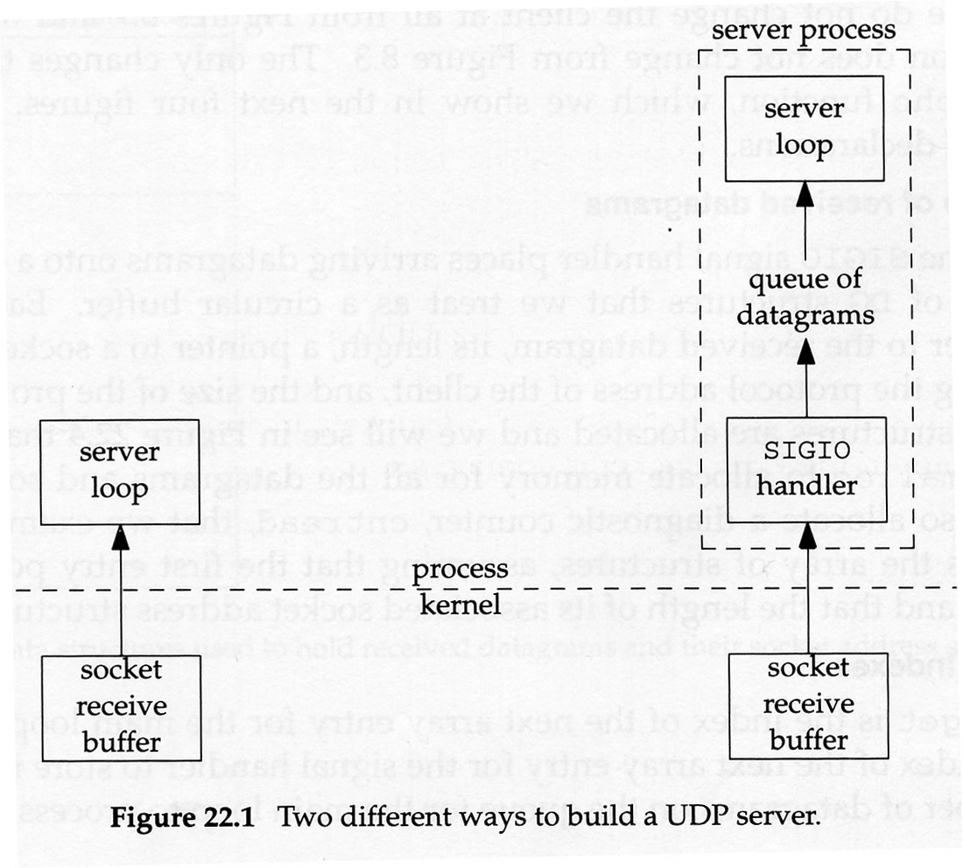
Two different UDP servers
Notes:
The diagram on the left shows a typical UDP server such as the echo server.
An real world example of signal-driven I/O is the NTP server. Its processing is more complicated since it must record the time when a datagram arrived. That is used to the client to calculate the RTT. If we used the technique on the left, there could be significant delay between the time a datagram arrived and the time it was processed.
Using the technique on the right, when the datagram arrives, the SIGIO handler is called. It gets the datagram, records the current time with the datagram and places it into a queue for further processing.

Slide 5
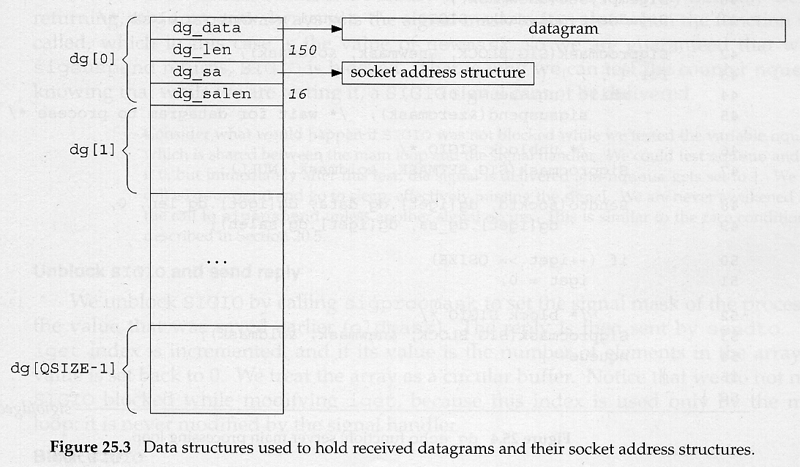
Example
Data structures for received datagrams and their socket address structures

Slide 6
Raw Sockets
Raw sockets provide three capabilites
  Read and write ICMPv4, IGMPv4, and ICMPv6 packets
  Read and write IPv4 datagrams with an IPv4 protocol field that is not processed by the kernel
  With a raw socket, a process can build its own IPv4 header, using the IP_HDRINCL socket option
Notes:
Raw sockets provide three features not provided by normal TCP and UDP sockets.
1 - The ping program for example sends ICMP ecdho requests and receives ICMP echo replies. The capability also allows applications that are build using ICMP or IGMP to be handled entirely as user processes, instead of putting more code into the kernel.
2 - Most kernels only process datagrams with protocol fields of 1 (ICMP), 2 (IGMP), 6 (TCP), and 17 (UDP). We can write programs for other protocols using raw sockets.
3 - For example, this can be used to build UDP or TCP packets. It can also be used by hackers - IP spoofing for example.

Slide 7
Raw Socket Creation 1
Steps are:
  int sockfd;
  sockfd = socket(AF_INET, SOCK_RAW, protocol);
  const int on = 1;
  if (setsockopt(sockfd, IPPROTO_IP, IP_HDRINCL,
  &on, sizeof(on)) < 0)
  error
  protocol is one of the constants IPPROTO_xxx defined in netinet/in.h, such as IPPROTO_ICMP
  Only the superuser can create a raw socket
Notes:
Here is an example to create an IPv4 raw socket. The second part means we will build our own IPv4 header.

Slide 8
Raw Socket Creation 2
bind can be called on the raw socket, but this is rare. A raw socket can only be bound to a local address, not a port number.
connect can be called on the raw socket, but this is rare. It only sets the foreign address and allows us to use write or send instead of sendto.
Notes:
1 - There is no concept of a port number with a raw socket. With regard to output, calling bind sets the source IP address that will be used for datagrams sent on the raw socket (but only if the IP_HDRINCL socket option is not set).If bind is not called, the kernel set the source IP address to the primary IP address of the outgoing interface.
2 - Connect only sets the foreign address. Again, there is no concept of a port number with a raw socket. With regard to output, calling connect lets us call write or send instead of sendto, since the destination IP address is already specified.

Slide 9
Raw Socket Output 1
Performed by calling sendto or sendmsg with the destination IP address
  write or send if the socket is connected
If IP_HDRINCL is not set, the starting address of the data for the kernel to send specifies the first byte following the IP header
  Kernel will build the IP header and prepend it to the data
  Protocol field from protocol in socket call

Slide 10
Raw Socket Output 2
If IP_HDRINCL is set, the starting address of the data for the kernel to write specifies the first byte of IP header.
  The amount of data to write must include the size of the IP header.
  The process builds the entire IP header, except:
    the IPv4 identification field can be 0 which tells kernel to set the value
    kernel always calculates and stores header checksum
    IP options may or may not be included

Slide 11
Raw Socket Output 3
The kernel fragments raw packets that exceed the outgoing interface MTU
With IPv4, the process must calculate and set any payload checksums contained in whatever follows the IPv4 header, e.g. ICMPv4 checksum.
With IPv6, the checksum for ICMPv6 is calculated by the kernel.
Notes:
2 - This does not apply to the IPv4 header, just other headers. For example and ICMPv4 checksum.

Slide 12
Raw Socket Input 1
Which datagrams does the kernel pass to raw sockets?
  Never pass UDP/TCP packets
  Most ICMP packets after the kernel has finished processing the ICMP message
  All IGMP packets after the kernel has finished processing the IGMP message
  All IP datagrams with a protocol field that the kernel does not understand
If fragmented, kernel reassembles before passing datagram to raw socket
Notes:
Received UDP and TCP packets are never passed to raw sockets. If a process wants to read IP datagrams containing UDP or TCP packets, they must be read at the datalink layer.
1 - In Berkeley-derived implementations, echo request, timestamp request, and address mask request messages are processed entirely by the kernel.
3 - The only kernel processing done on these packets is the minimal verification of some IP header fields such as the IP version, IPv4 checksum, and destination IP address.

Slide 13
Raw Socket Input 2
When the kernel has an IP datagram to pass to the raw sockets, a copy of the IP datagram is delivered to each matching socket (if all three tests are true)
  If a nonzero protocol is specified when the raw socket is created, the protocol field of the IP datagram must match the socket’s protocol
  If bind is called, destination address of the datagram must match the socket’s bound address
  If connect is called, source address of the datagram must match the socket’s connected address

Slide 14
Raw socket input 3
If a raw socket is created with a protocol 0, and neither bind nor connect is called, then that socket receives a copy of every raw datagram the kernel passes to raw sockets
Whenever a datagram is passed to a raw IPv4 socket, the entire datagram including IP header is passed to it
  For a raw IPv6 socket, only the payload is passed to the socket

Slide 15
Ping
How to make a ping program?
  A raw socket is created for ICMP protocol
  The main function is receiving IP datagrams in a loop
    When a datagram is received, the sequence number and calculated RTT are printed out.
  An alarm is set every second and the SIGALRM signal handler sends an ICMP packet with a sequence number and a timestamp
    The checksum of the ICMP packet is calculated
Notes:
The textbook presents a ping program that works with IPv4 and IPv6. It is missing many of the features of the regular ping program which has been victim of creeping featurism. This version takes only a ‘v’ flag for verbose. It requires an IP address or IP name.
The basic operation is simple: an ICMP echo request is sent to some IP address and that node responds with an ICMP echo reply.
The program operates in two parts: One half reads everything received on a raw socket, printing the ICMP echo replies; the other half send an ICMP echo request once per second. The second half is driven by a SIGALRM signal once per second.

Slide 16
Traceroute
How to make a traceroute program?
  Create two sockets, one is SOCK_DGRAM, the other is SOCK_RAW
  The SOCK_DGRAM socket is used to send IP datagrams with TTL starting from 1
    ‘time exceeded in transit’ ICMP errors will result until TTL is large enough
  The SOCK_RAW is used to receive ICMP packets
  Send a datagram, and then wait to receive an ICMP packet
  Repeat the above until ‘port unreachable’ ICMP packet received.
Notes:
The textbook also presents a simplified traceroute program that works for both IPv4 and IPv6.
Recall that traceroute lets us determine the path that IP datagrams follow from our host to some other destination.
The program starts by sending a UDP datagram to the destination with a TTL of 1. This datagram causes the first-hop router to return a ‘time excceeded in transit’ ICMP error. The TTL is then increased by one and another UDP datagram is sent, which locates the next router in the path. The TTL field is increased until the datagram reaches the destination. The goal is to have that host return a ‘port unreachable’ ICMP error. This is done by sending the UDP datagram to a random port that is hopefully not in use on that host.

Slide 17
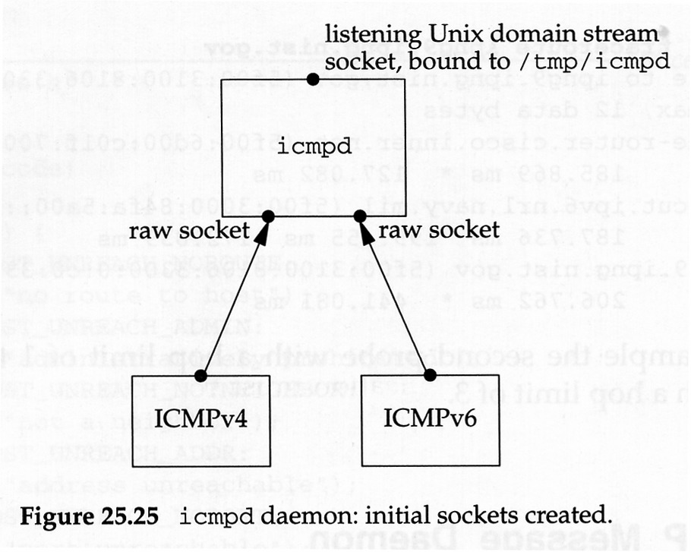
ICMP Daemon 1
Allow applications to receive asynchronous ICMP errors in detail (refer to the directory icmpd)
Notes:
Receiving asynchronous ICMP errors on a UDP socket is a problem. ICMP errors are received by the kernel, but are rarely delivered to the application that needs to know about them. In the sockets API, it requires connecting the UDP socket top one IP address to receive these errors. The reason for this limitation is that the only error returned from recvfrom is an integer errno code and if the application sends datagrams to multiple destinations and then calls recvfrom, this function cannot tell the application which datagram encountered an error.
The textbook has code for a ICMP message daemon called icmpd that does not require any kernel changes.
When icmpd starts is creates a raw IPv4 socket and a raw IPv6 socket and receives all ICMP messages the kernel passes to these two raw sockets. It also creates a Unix domain stream socket, binds it to the pathname /tmp/icmpd, and listens for incoming client connects to this pathname.

Slide 18
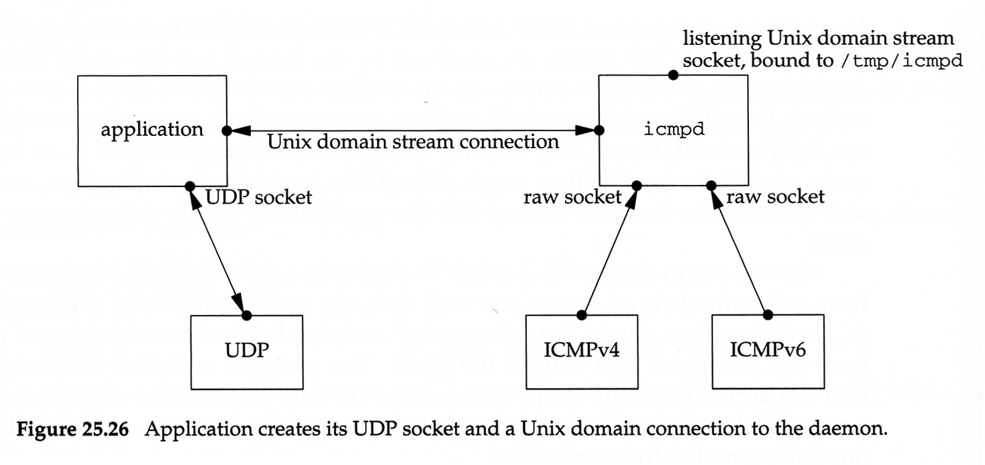
ICMP Daemon 2
Notes:
Now a UDP application starts. It will also be a client to the icmpd daemon.
The client creates its UDP socket, the socket for which it wants to receive asynchronous errors. The application must bind an ephemeral port to this socket. It then creates a Unix domain socket and connects to icmpd’s well-known pathname.

Slide 19
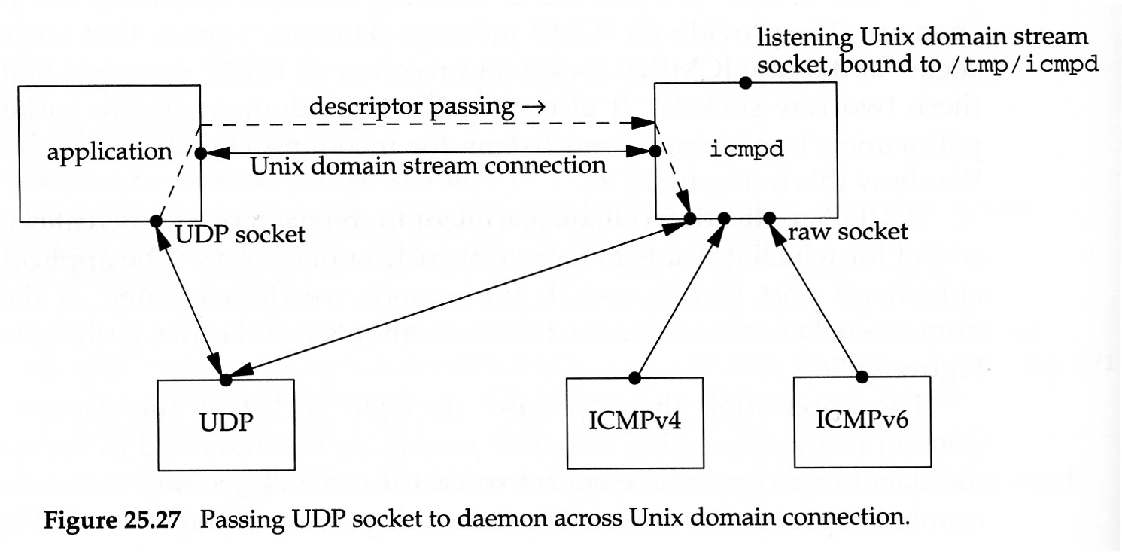
ICMP Daemon 3
Notes:
The application next passes its UCP socket to the daemon across the Unix domain connection using descriptor passing. The gives the daemon a copy of the socket so that it can call getsockname and obtain the port number bound to the socket.

Slide 20
ICMP Daemon 4
Notes:
After icmpd obtains the port number bound to the UDP socket, it closes its copy of the socket, which takes us back to the situation of the previous slide. (Which is shown above)
From this point on, any ICMP errors the daemon receives in response to UDP datagrams send from the port bound to the application’s UDP socket cause the daemon to send a message across the Unix domain socket to the application. The application must use select or poll, awaiting data on either the UDP socket or the Unix domain socket.

Slide 21
Datalink Access
Datalink access provides the following capabilities
  The ability to watch the packets received by the datalink layer, allowing programs such as tcpdump to be run on normal computer systems
  The ability to run certain programs as normal applications instead of as part of the kernel, e.g. RARP server.
  Linux uses PF_PACKET as the domain for sockets to support datalink access
Notes:
1 - One must put the network into promiscuous mode for this to work. Also Ethernet switches prevent this from working. Some switches have a special monitor port or port mirroring capability.
2 - RARP requests are not IP datagrams.

